Slide 1


Consumer Loan Default
Prediction
Project by:
Rahul C Pal
Guided by:
Venkat Reddy Konasani
Bhuvnesh Kumar
https://statinfer.com/

Slide 2
INTRODUCTION
Banks play a crucial role in market economies .
The loan is one of the most important products of the banking.
All the banks are trying to figure out effective business strategies to persuade customers to implements their loans. But some customers are behave very negatively after their application approved.
Loans default will cause huge loss for the banks, so they pay much attention on this issue and apply various method to detect and predict default behaviours of their customers.
To cease this situation, bank have to find some method to predict
customers behaviour.
Machine learning algorithms have a pretty good performance on this purpose, which are widely-used by the banks.

Slide 3
OVERVIEW
Introduction
Problem Statement
Exploratory Data Analysis
Data Cleaning
Identify Outliers and Missing Values
Outliers and Missing Values Treatments
Clean Data
Prepare Data for Analysis
Model Building
Logistic Regression
Decision Trees
Neural Networks
Support Vector Machine
Random Forest
Boosting
Model Validation
Accuracy
Sensitivity & Specificity
AUC & ROC
Conclusion

Slide 4
PROBLEM STATEMENT
Build a model which make a guess at the probability of default, are the method banks use to determine whether or not a loan should be granted and borrowers can use to help make the best financial decisions.
The goal is to build a different machine learning models that banks can use to help predict the customers behaviour.

Slide 5
EXPLORATORY DATA ANALYSIS
This is credit data, last two years data 150000 borrowers some of customers pay back some are delinquent(bad customer).
The data set used for this project is provided by Statinfer.
The data set has 150000 rows and 12 columns.
The columns represent variable names, indicates information borrowers and the outcomes of their loan repayment.
SeriousDiqin2yrs columns is target of our algorithm

Slide 6
EXPLORATORY DATA ANALYSIS
DATA DICTIONARY:
Variable Name | Description
SeriousDlqin2yrs | Person experienced 90 days past due delinquency or worse
RevolvingUtilizationOfUnsecuredLines | Total balance on credit cards and person lines of credit except real estate and no instalment debt like car loans divided by the sum of credit limits
age | Age of borrower in years
NumberOfTime30-59DaysPastDueNotWorse | Number of times borrower 30-59 days past due but no worse in the last 2 years
DebtRatio | Monthly debt payment, alimony, living costs divided by monthly gross income
MonthlyIncome | Monthly income
NumberOfOpenCreditLinesAndLoans | Number of Open loans(instalment like car loan or mortage) and Lines of credit(credit cards)
NumberOfTime90DaysLate | Number of time borrower has been 90 days or more past due
NumberRealEstateLoansOrLines | Number of mortgage and real estate loans including home equity line of credit
NumberOfTime60-89DaysPastDueNotWorse | Number of time borrower has been 60-89 days past due but no worse in the last 2 years
NumberOfDependents | Number of dependents in family excluding themselves

Slide 7
DATA CLEANING
STEPS:
Identify Outliers and Missing value
Categorical Variables Exploration
Continuous Variables Exploration
Missing Values and Outlier Treatment

Slide 8
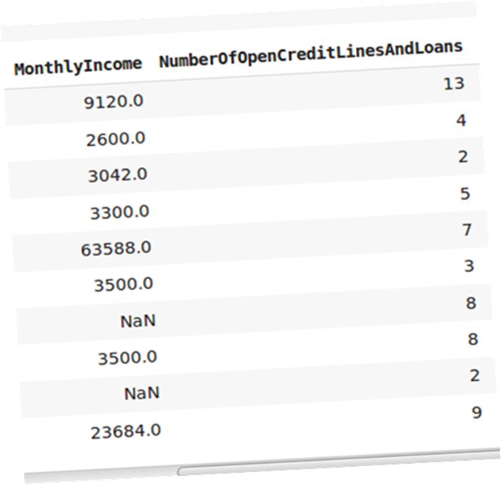
DATA CLEANING
STEPS:
Identify Outliers and Missing value
MonthlyIncome

Slide 9
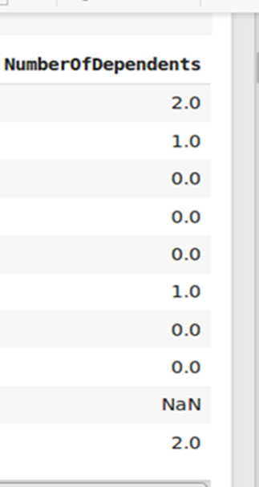
DATA CLEANING
STEPS:
Identify Outliers and Missing value
NumberOfDependents

Slide 10
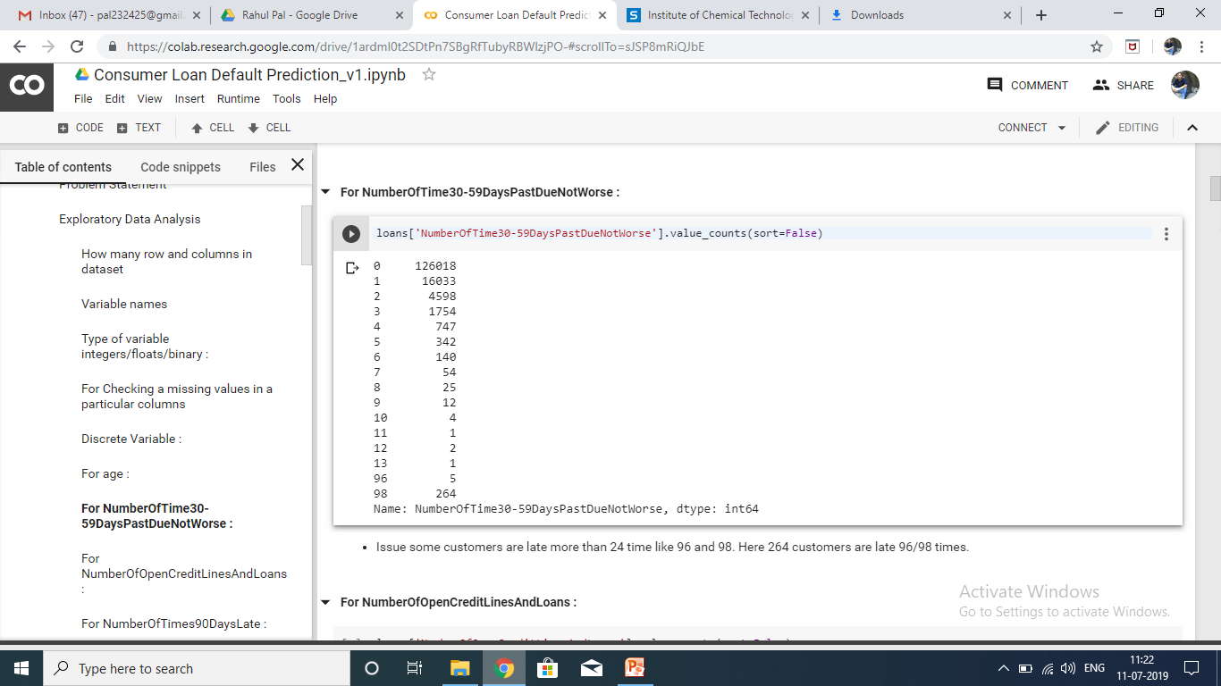
DATA CLEANING
STEPS:
Categorical Variables Exploration
NumberOfTime30-59DaysPastDueNotWorse
NumberOfTime60-89DaysPastDueNotWorse.
NumberOfTime90DaysPastDueNotWorse.

Slide 11
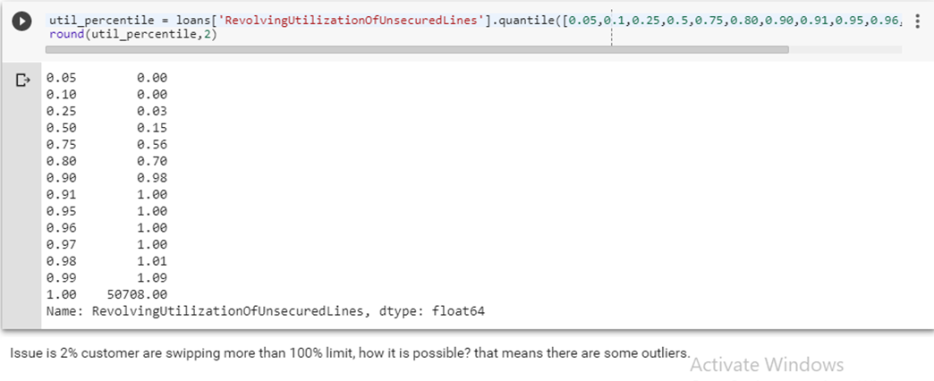
DATA CLEANING
STEPS:
Continuous Variables Exploration
RevolvingUtilizationOfUnsecuredLines

Slide 12
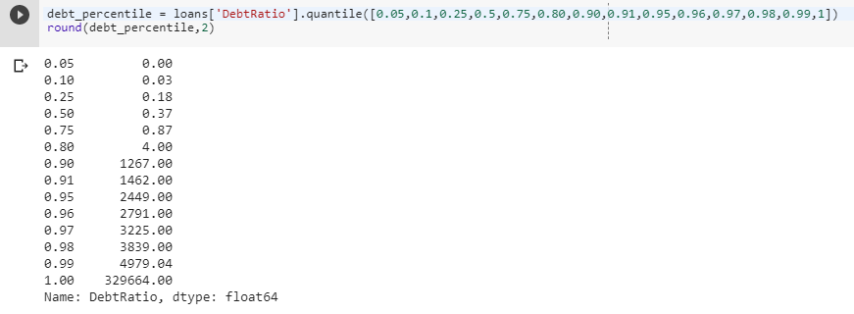
DATA CLEANING
STEPS:
Continuous Variables Exploration
DebtRatio
20% customer has debt ratio more than 100% it is not possible.
Monthly debt payment, alimony, living costs divided by monthly gross income.

Slide 13
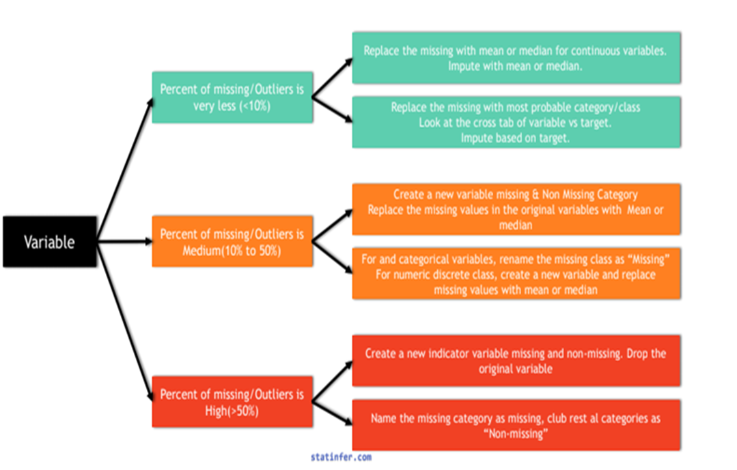
DATA CLEANING
STEPS:
Missing Values and Outlier Treatment

Slide 14
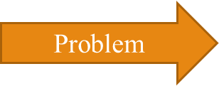
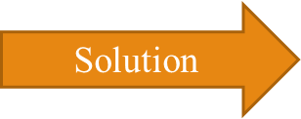
DATA CLEANING
PROBLEMATIC VARIABLES
Problem
19.82% customer have missing values
MonthlyIncome
Solution
Create a new variable missing and non-missing category
Replace all missing value in the original with median
2.6% customer have missing values.
NumberOf
Dependents
Replace missing with most probable class

Slide 15
DATA CLEANING
PROBLEMATIC VARIABLES
Problem
0.18% customer have default values
NumberOfTime3059DaysPastDueNotWorse
Solution
Look at the cross tab with target
Replace the default with most probable class
Same treatment for : NumberOfTime60-89DaysPastDueNotWorse
NumberOfTime90DaysPastDueNotWorse
3% customer are swiping more than 100% limit
RevolvingUtilization
OfUnsecuredLines
Replace the default with median

Slide 16
DATA CLEANING
PROBLEMATIC VARIABLES
Problem
20% customer has debt ratio more than 100% it is not possible
DebtRatio
Solution
Create a new variable missing and non-missing category
Replace all missing value in the original with mean
One customer age is 0
Age
Replaced 0 age with median

Slide 17
DATA CLEANING
PREPARE DATA FOR ANALYSIS
CHECKS:
A variance inflation factor (VIF) quantifies how much the variance is inflated.
VIF indicates multicollinearity, How much variables are correlated with each other.
If VIF is more than 5 then, drop that variable.

Slide 18
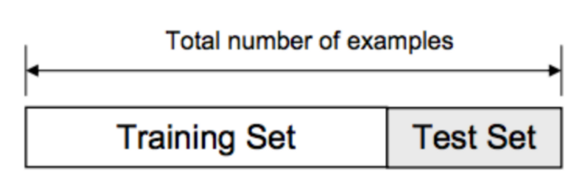
MODEL BUILDING
WHAT TO DO BEFORE MODEL BUILDING:
1. TRAIN/TEST SPLIT:
Split the data into training data and test data.
The training dataset contains a known output and the model learns on this data in order to be generalized to other data later on.
We have the test dataset in order to test our model’s prediction on this subset.

Slide 19
MODEL BUILDING
WHAT TO DO BEFORE MODEL BUILDING:
2. NORMALIZATION:
Normalization is to change the values of numeric columns in the dataset to a common scale, without distorting differences in the ranges of values.
It is required only when features have different ranges.

Slide 20
MODEL BUILDING
WHAT TO DO AFTER MODEL BUILDING:
1. MODEL VALIDATION
Model validation is the process where a trained model is evaluated with a test data set.
The test data set is a separate portion of the same data set from which the training set is derived.
The main purpose of using the testing data set is to test the generalization ability of a trained model.
Confusion matrix, Specificity, Sensitivity ROC, AUC are validation measure.

Slide 21
MODEL BUILDING
WHAT TO DO AFTER MODEL BUILDING:
2. CLASSIFICATION TABLE
Predicted Actual Classes Classes | Positive(0) | Negative(1)
Positive(0) | True positive (TP). Actual condition is Positive, it is truly predicted as positive. | False Negatives(FN) Actual condition is Positive, it is falsely predicted as negative.
Negative(1) | False Positives(FP). Actual condition is Negative, it is falsely predicted as positive. | True Negatives(TN) Actual condition is Negative, it is truly predicted as negative.
Accuracy = (TP+TN)/(TP+FP+FN+TN)
Misclassification Rate = (FP+FN)/(TP+FP+FN+TN)

Slide 22
MODEL BUILDING
WHAT TO DO AFTER MODEL BUILDING:
3. SENSITIVITY & SPECIFICITY
Sensitivity and Specificity are derived from confusion matrix.
Sensitivity: Percentage of positives that are successfully classified as positive.
Sensitivity = True Positive / (True Positive + False Negative)
Specificity: Percentage of negatives that are successfully classified as negatives.
Specificity = True Negative / (False Positive+ True Negative)
4. AUC (Area under curve) – ROC (Receiver operating characteristic)
ROC curve is drawn by taking False positive rate on X-axis and True positive rate on Y- axis.
ROC tells us, how many mistakes are we making to identify all the positives?
ROC is a probability curve and AUC represents degree or measure of separability.

Slide 23
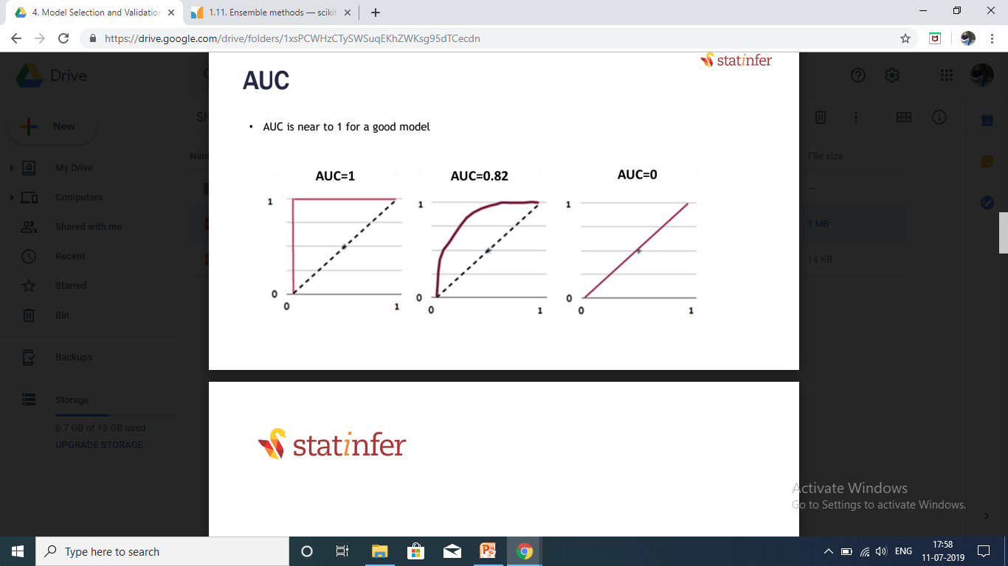
MODEL BUILDING
WHAT TO DO AFTER MODEL BUILDING:
4. AUC (Area under curve) – ROC (Receiver operating characteristic)
It tells how much model is capable of distinguishing between classes.
AUC is near to 1 for a good model.

Slide 24
MODEL BUILDING
Logistic Regression
Decision Trees
Neural Networks
Support Vector Machine
Random Forest
Boosting
PREREQUISITE (In Python)
Pandas - To load the data file as a Pandas data frame and analyze the data.
Numpy - For scientific computing in Python. It provides a high performance
multidimensional array object, and tools for working with these
array.
From Sklearn, I have imported the datasets module, so I can load a sample dataset, and the linear_model, so I can run a logistic regression.
From Matplotlib I’ve imported pyplot in order to plot graphs of the data.

Slide 25
MODEL BUILDING
PREREQUISITE (In Python)
From Sklearn, sub-library model_selection, I have imported the train_test_split so I can, split data to training and test sets
From Sklearn, sub-library model_selection, I have imported the cross_val_predict so I can, calculate accuracy
From Sklearn, sub-library metrics, I have imported roc_curve, roc_auc_score , auc and confusion_matrix so I can, calculate roc, auc score and confusion matrix
From sklearn, sub-library preprocessing, I have imported StandardScaler
so I can, Normalize the dataset
From Sklearn, sub-library tree, I have imported the DecisionTreeClassifier
so I can run a Decision Tree

Slide 26
MODEL BUILDING
PREREQUISITE (In Python)
Neurolab - Neurolab is a simple and powerful Neural Network Library for
in python. It contains neural networks, train algorithms.
From Sklearn, I have imported svm so I can run a Support Vector Machine
From Sklearn, sub-library model_selection, I have imported the GridSearchCV, so I can tune our hyperparameters and get the best set of parameters
From Sklearn, sub-library ensemble, I have imported the RandomForestClassifier so I can run a Random Forest
From Sklearn, sub-library ensemble, I have imported the GradientBoostingClassifier, so I can run Boosting

Slide 27
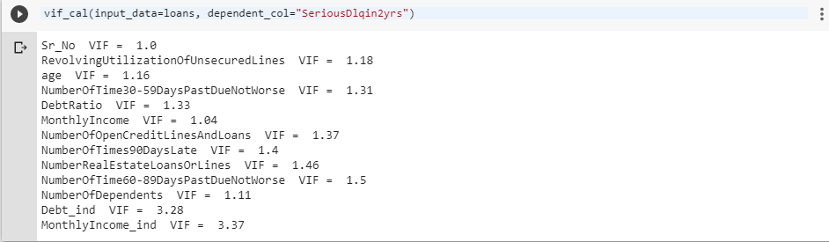
MODEL BUILDING
1. Logistic Regression
It is regression analysis to use when the dependent variable is binary.
It is used to describe data and to explain the relationship between dependent binary variable and one or more independent variables
VIF value of all variable is less than 5 so there is no multicollinearity in variables now, for building a model we will use all variables.

Slide 28
MODEL BUILDING
1. Logistic Regression
On Training dataset
On Test dataset
Accuracy : 0.93587407
Training error : 0.0641259
Specificity : 0.1289499944
Sensitivity : 0.993641898
Accuracy : 0.9362
Test error : 0.06379
Sensitivity : 0.994211
Specificity : 0.13008
Our problem statement we have to identify defaulter more accurately.
In our dataset 139974 person are good customer(0) and only 10026 person are bad customer(1).

Slide 29
MODEL BUILDING
1. Logistic Regression
So our goal is to predict bad customer i.e. Actual condition is Negative, it is truly predicted as negative, so specificity should be high.
So now we will used up-sampling using class_weight balanced to increase our specificity.
On Training dataset
On Test dataset`
Accuracy : 0.805762
Train error : 0.194237
Sensitivity : 0.812128
Specificity : 0.716681
Auc_score : 0.76425
Accuracy : 0.806866
Test error : 0.193133
Sensitivity : 0.813707
Specificity : 0.71330
Auc_score : 0.76615

Slide 30
MODEL BUILDING
2. Decision Trees
Decision tree decide the whole dataset into segments.
The hyper parameters for DecisionTreeClassifier are
max_depth
min_samples_leaf
min_samples_split
On Training dataset
On Test dataset
Accuracy : 0.7753037
Sensitivity : 0.7707156
Sensitivity : 0.7728178
Specificity : 0.81005
Auc_score : 0.79143498
Specificity : 0.7654170
Auc_score : 0.76541706
Accuracy : 0.77

Slide 31
MODEL BUILDING
3. Neural Network
Neural networks are multi layer nonlinear regression models.
Neural networks are multi-layer networks of neurons that we use to classify things, make predictions.
The neural network technique automatically takes care of all the intermediate outputs using hidden layers.
On Training dataset
On Test dataset`
Accuracy : 0.78449112
Accuracy : 0.78492157
Sensitivity : 0.8055394
Specificity : 0.7515077
Auc_score : 0.78370099
Sensitivity : 0.8126031
Specificity : 0.7515077
Auc_score : 0.7840403

Slide 32
MODEL BUILDING
4. Support Vector Machine
A support vector machine takes data points and outputs the hyper plane(which in n- dimensions, where n is number of independent variable) that best separates the outputs.
In our case outputs is whether customer is default or non-default.
That line is the decision boundary: anything that falls to one side of it we will classify as Defaulter, and anything that falls to the other as non-defaulter.
On Training dataset
On Test dataset
Accuracy : 0.8934560
Accuracy : 0.875073
Sensitivity : 0.8991786
Specificity : 0.8873065
Auc_score : 0.8932425
Sensitivity : 0.872125
Specificity : 0.878222
Auc_score : 0.875173

Slide 33
MODEL BUILDING
5. Random Forest
Random forest, like its name implies, consists of a large number of individual decision trees that operate as an ensemble.
Each individual tree in the random forest spits out a class prediction and the class with the most votes becomes our model’s prediction.
On Training dataset
On Test dataset
Accuracy : 0.8055943
Accuracy : 0.8034181
Sensitivity : 0.828497
Specificity : 0.7810381
Auc_score : 0.80476800
Sensitivity : 0.823662
Specificity : 0.781351
Auc_score : 0.802507

Slide 34
MODEL BUILDING
6. Boosting
Boosting is one more famous ensemble method. Boosting uses a slightly different techniques to that of bagging.
Boosting in general decreases the bias error and builds strong predictive models. Boosting is an iterative technique. We adjust the weight of the observation based on the previous classification.
If an observation was classified incorrectly, it tries to increase the weight of this observation and vice versa.
On Training dataset
On Test dataset
Accuracy : 0.8055943
Accuracy : 0.8034181
Sensitivity : 0.828497
Specificity : 0.7810381
Auc_score : 0.80476800
Sensitivity : 0.823662
Specificity : 0.781351
Auc_score : 0.802507

Slide 35
CONCLUSION
Support Vector machine is good model among all

Slide 36
THANK YOU

